Slide 1

Introduction to Data Science
By-
Pawan Kumar Ganjhu – Data & AI @ Philips

Slide 2
Why should you think career as Data Scientist?
Data Scientist is the best job of the 21st century - Harvard Business Review
Global Big Data market to reach $122B in revenue by 2025 – Frost & Sullivan
The US alone could face a shortage of 1.4 -1.9 million Big Data Analysts by 2019 – Mckinsey
Right from MNCs to startups, almost every company is trying to give solution using AI while includes Bot Building, Predictive Analysis and Recommendation Systems.

Slide 3


Learning Objective
1.
2.
Apprehend the field of data science impact and importance in the society
Reflect on its applications, importance and advantages
Begin
Progress
Continue

Slide 4






Contents
Walkthrough- Real Time Application
07
Importance of Data Science?
06
Applications & Impact of Data Science?
05
How to become Data Scientist?
04
Pre-requisite
03
What is Data Science?
02
Why talk about Data Science?
01

Slide 5
01 Why talk about Data Science?

Slide 6



02 What is Data Science?
History & Origin
Data Science is a new term. But in the same sense as Columbus discovered America.
01
02
What is Data Science?
Data science is an interdisciplinary field that uses scientific methods, processes, algorithms and systems to extract knowledge and insights.
03
Data Science Life Cycle
A data science life cycle is an iterative set of data science steps you take to deliver a project or analysis.
Continued…

Slide 7
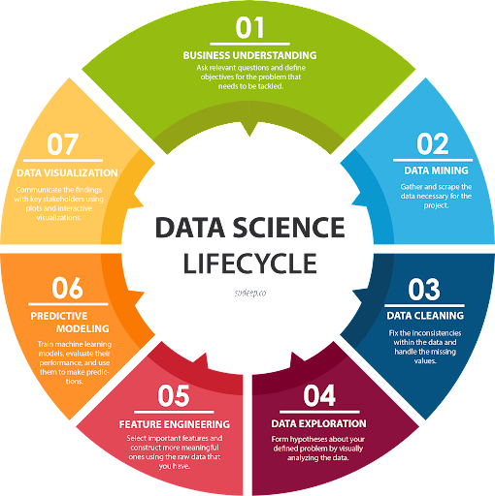
Data Science Life Cycle
01 Business Understanding
02 Data Mining
03 Data Cleaning
04 Data Exploration
05 Feature Engineering
06 Predictive Modeling
07 Data Visualization
Continued…

Slide 8
Steps in Data Science Life Cycle
01 Business Understanding: Define the problem you are trying to solve using data science.
02 Data Mining: Collect as much as relevant data as possible.
03 Data Cleaning: Clean the data and make it into a desirable form.
04 Data Exploration: Use visualization tools to explore the data and find interesting patterns.
05 Feature Engineering: Transform raw data into more informative features.
06 Predictive Modeling: Experiment with different machine learning algorithms to find out which works best for our data.
07 Data Visualization: Communicate the results visually using the most suitable visualization techniques for effective interpretation by stakeholders.

Slide 9
03 Pre-requisite
Project
Technology
01
Understanding of Data
01
Language: Python, R
02
Understanding of algorithms/logic
02
Query: SQL/ MySQL
03
Understanding of programming
03
Big Data
04
Understanding of Statistics
04
Cloud: AWS, Azure, GCP
05
Understanding of business domain
05
Visualization

Slide 10
04 How to become Data Scientist?
Learning
Skills
Be proficient
Learn Data Science, Statistics & Probability, Data Structure & Algorithms, Database, Operating Systems
Machine Learning
Big Data
Sharpen Skills
Be good at Python/ R, SQL, Eecel
Learn Visualization – Tableau/ QlickView/ PowerBI
Communication

Slide 11
05 Applications & Impact of Data Science?
Applications
Impact
01
Health Care
01
Saving Energy
02
Security
02
Protection
03
Banking and Finances
03
Data Driven Health Care
04
Recommendations Systems
04
Prediction and Forecasting
05
ETC.
05
ETC.

Slide 12
06 Importance of Data Science?
01
Data Science helps brands to understand their customers in a enhanced & empowered manner
02
It allows brands to communicate their story in engaging way.
03
Big data is a field that is constantly growing & evolving.
04
It’s finding and results can be applied to almost all sectors.
05
Data Science is accessible to almost all sectors.

Slide 13
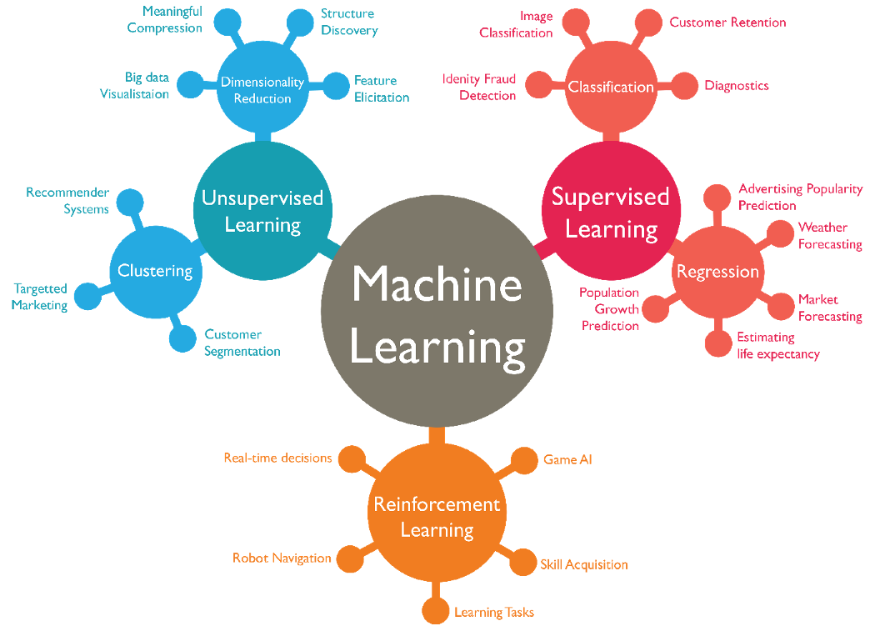
07 Walkthrough- Types of Learning
Continued…

Slide 14
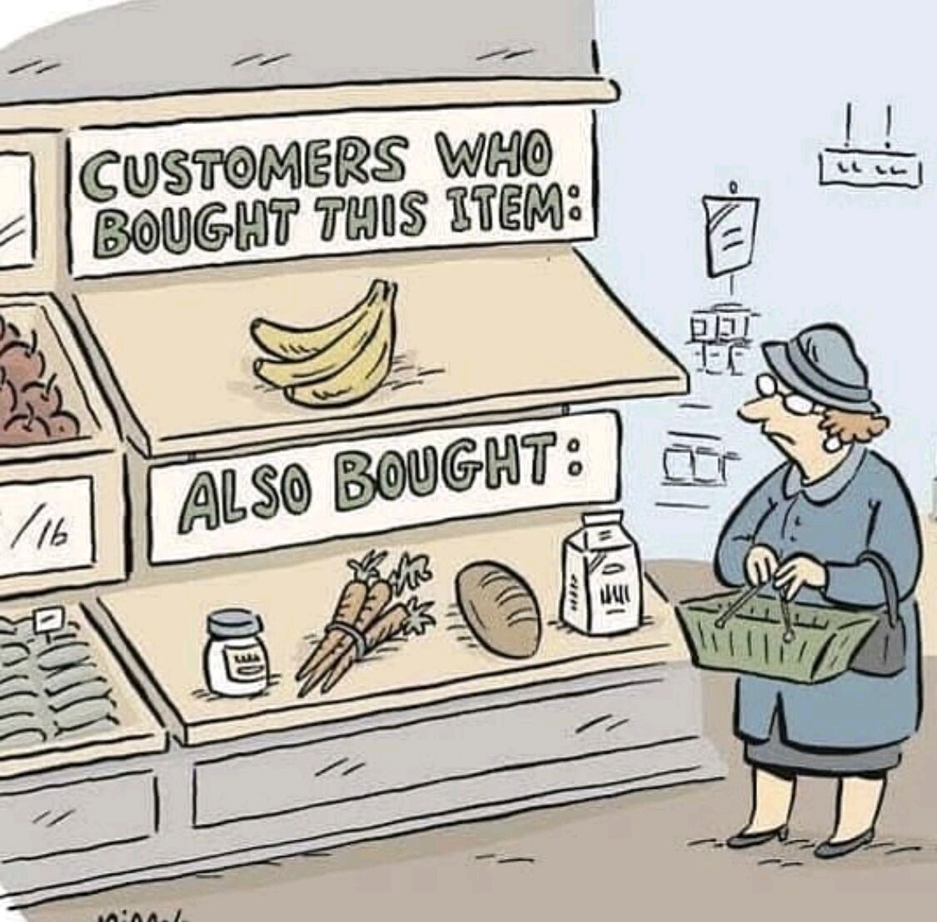
Example
Can you guess, what is happening?
Continued…

Slide 15
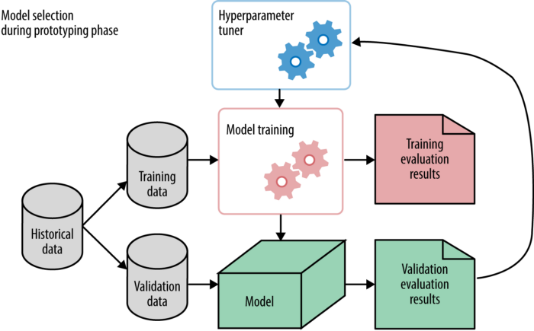
Walkthrough- Real Time Application
Explanation of Code by using concept of Cost Prediction of Products

Slide 16
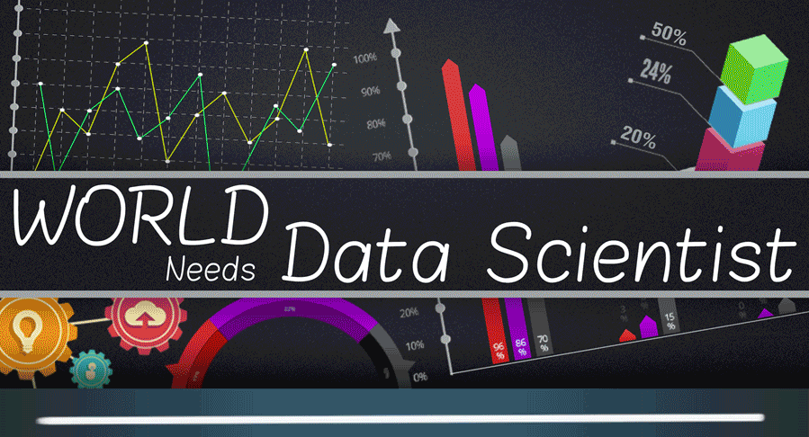

Slide 17
Takeaway
Building a Portfolio
Linkedin- Professional Connect
Github- Code Repository
Kaggle- Data Science Practice
Medium- Blogs & articles
Open-Source Initiative
Tools to work on
Anaconda (Jupyter + Spyder)
Google Colab
Crestle
Visualization
Programming Practice
Hackerrank
Hackerearth
LeetCode

Slide 18
Connect with us-
Pawan
Linkedin- https://www.linkedin.com/in/pawan-kumar-ganjhu-90723112a/
Medium- https://pawankg.medium.com/
Github- https://github.com/pganjhu
Anjali
Linkedin- https://www.linkedin.com/in/anjali-choudhary/
Github- https://gist.github.com/anjalinagel12

Slide 19
Thank you for your patience and have a great career ahead…

